Slide 1
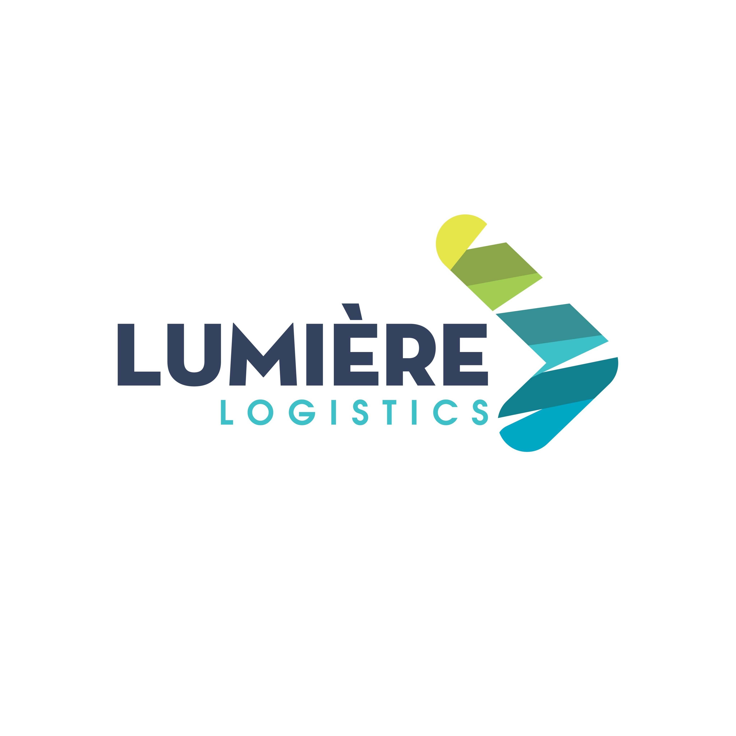
Lumière Logistics Co., Ltd
Introduction

Slide 2
Agenda
About Us
What do we do
How we create Value

Slide 3
About us

Slide 4
Increasing complexity in global supply chains is making them inefficient, vulnerable and unsustainable. At Lumière, our strategic vision is to become the efficient solution provider, offering truly integrated logistics solutions that connect, protect and simplify our customers’ supply chains.

Slide 5
What do we do

Slide 6
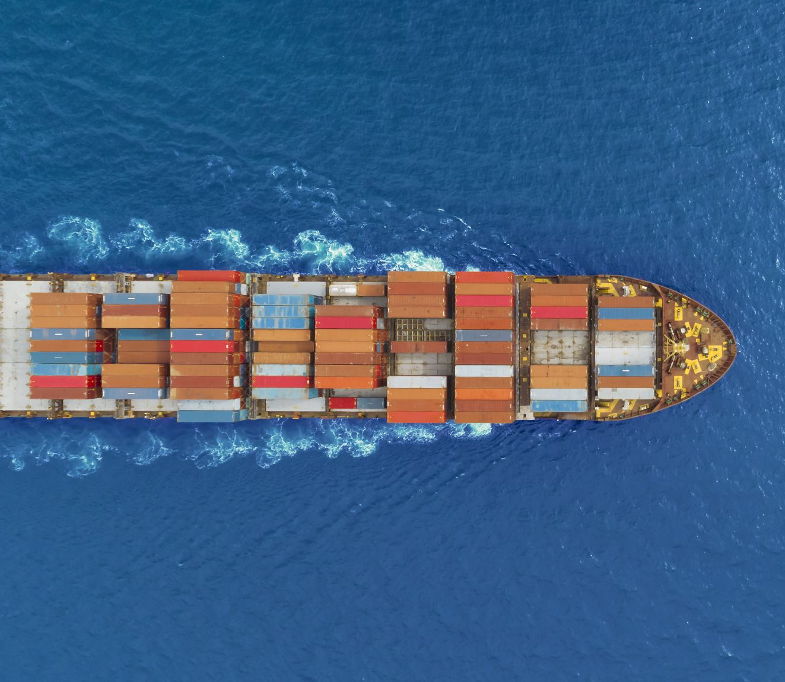
Sea Freight
Lumière has an extensive global network of freight forwarders; we have a professional expertise in handling all kinds of special and emergency situations whilst providing safe and convenient logistics solutions for customers

Slide 7
Air Freight
Lumière has the advantage of routing resources around the world, as well as business collaborations with many domestic airlines.
We provide the optimal solutions for all Air Shipments from time-sensitive to cost-focus service.

Slide 8
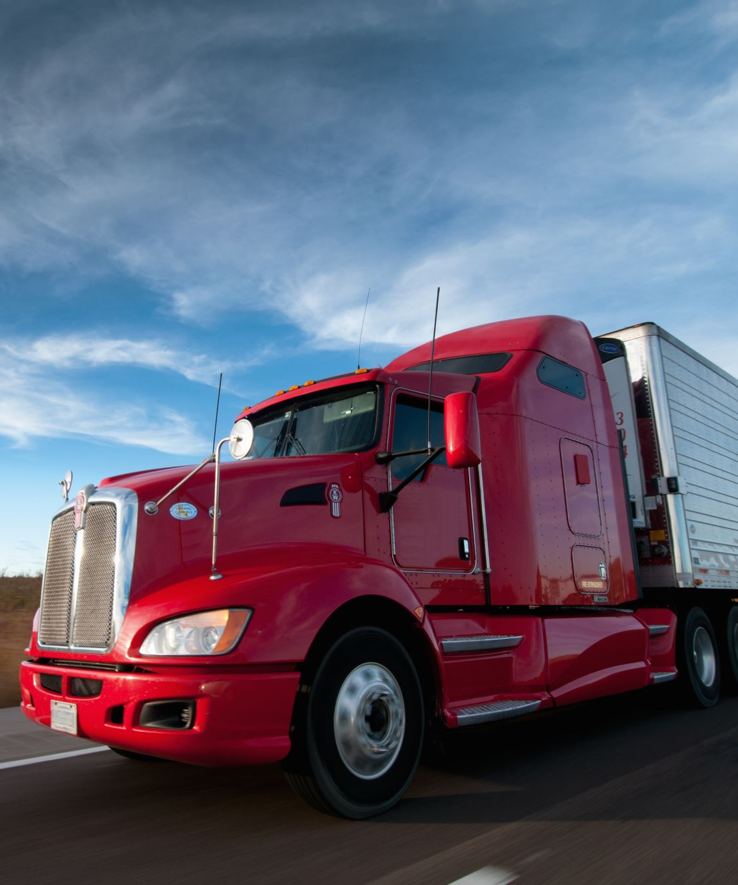
Road Freight
Our road freight products offer superior services, including standard services such as groupage solutions, palletized and non-palletized freight (LTL), full truckload (FTL) and less-than-truckload (LTL) shipments, as well as high-security and temperature-controlled transport.

Slide 9
Customs Clearance Procedures
The Lumière Customs Department provides professional consultancy service that helps to ensure the smooth movement of the goods.

Slide 10
How we create value

Slide 11
Value created
Our Long-Standing Shareholders
An integrated transport and logistics structure
Shareholders with strong background in the industry
Innovative Supply Chain
One expert solution per business line
Customer-centric Attitude
An organization model at both global and local levels

Slide 12
Thank You!

